Slide 1
Intro to Web

Slide 2
How the web works:
URL (uniform resource location)
Its is how we locate a resource on the internet
After typing the URL - there are two sides involved
(client server model)
Using DNS - domain name system, its a type of service on the internet that convert domain name to IP address.
The client requests a service and the server provide that service
This is request is based on protocol called HTTP(hypertext transfer protocol)
it is a language that a client and server use to talk to each other(for communicating over the internet).
2.HTTPS -
which is simply HTTP with ENCRYPTION.
The messages between the client and the server are encrypted .
Every data exchange using http includes two messages:
1.Request
2.Respond

Slide 3
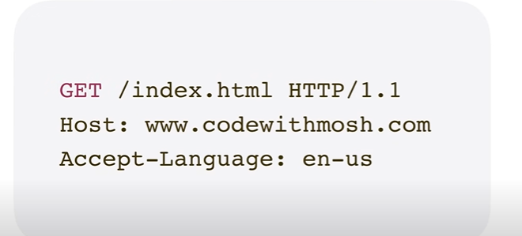
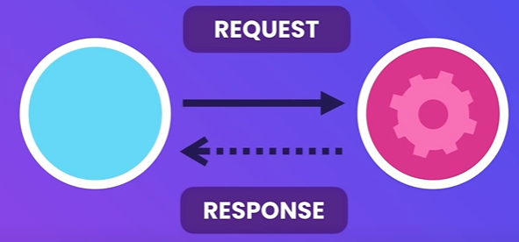
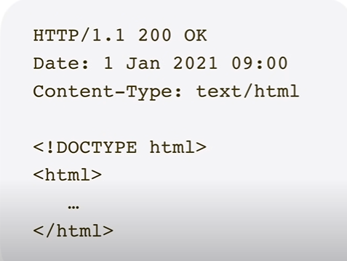
Example:
request:
Request :
This comes from the client and tells the server I want to get a file called /index.html using HTTP version 1.1
Index.html usually represents the home page of a website
HOST - www.example.com
Language - the language that the client can accept
Response:
1.Http version and status code (200 means successful)
2.date and time of the response
3.type of content server sends to the client
4. Html document (represents the homePage)
response:

Slide 4
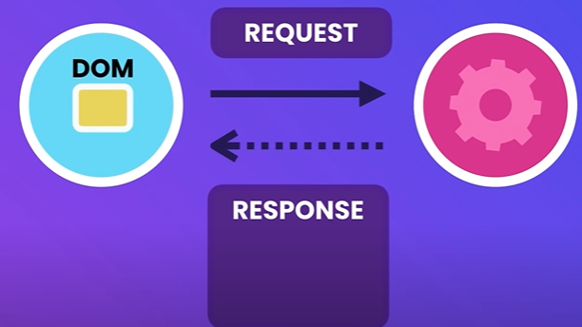
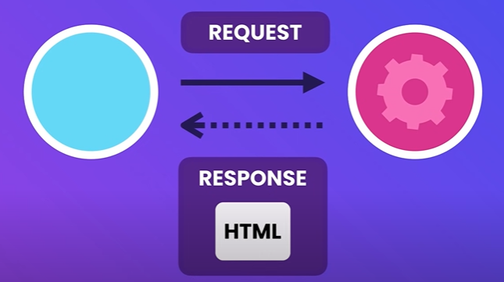
DOM - Document Object Model
Represents objects and elements in our html document
Like (paragraphs of text, images, links , etc …)
Html might include references to other resources like images and fonts , each of these resources has an address of url, for each resource the browser sends a separate requests to the server to fetch that resource
Many of these requests run in parallel so we can see the web page as quickly as possible .
THEN - once the browser gets the resources it renders the html document means displaying it

Slide 5
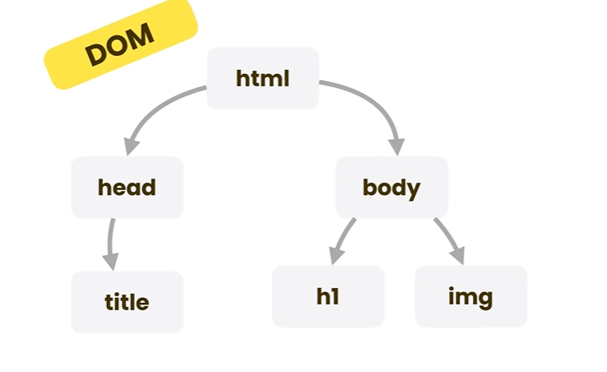
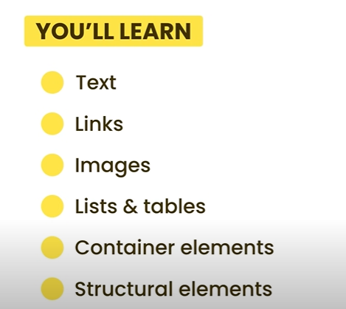

Slide 6
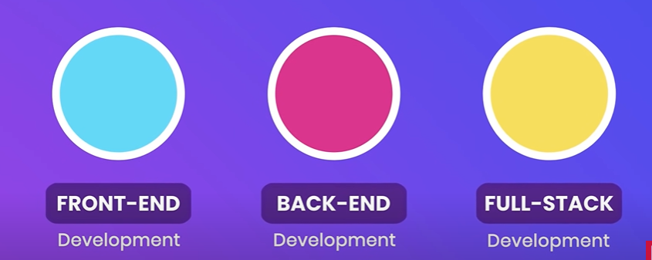
What is Full Stack Development?
Full stack development refers to the practice of developing both the front-end and back-end portions of a web application. This means that full stack developers are responsible for creating the user interface, as well as the server-side logic and database integration.
Compared to front-end or back-end development, full stack development requires a wider range of skills and knowledge. Full stack developers must be familiar with multiple programming languages, frameworks, and tools in order to create a fully functional web application.

Slide 7
What is the MERN Stack?
The MERN stack is a popular technology stack used in full stack development. It consists of four main components: MongoDB, Express, React, and Node.js. MongoDB is a NoSQL database, Express is a web application framework for Node.js, React is a JavaScript library for building user interfaces, and Node.js is a server-side JavaScript runtime environment.
The MERN stack is known for its flexibility and scalability, making it a popular choice for building complex web applications. Additionally, because all of the technologies in the stack use JavaScript, it can be easier for developers to learn and work with.

Slide 8
Front-End Development
Front-end development refers to the creation of the user interface and user experience of a web application. This includes designing and coding the layout, visual elements, and interactivity of the application.
Common tools and technologies used in front-end development include HTML, CSS, JavaScript, and various frameworks such as React, Angular, and Vue. Front-end developers must also be familiar with responsive design principles to ensure that their applications are accessible on a variety of devices.
Frameworks: build apps faster
React: the most popular tool, once you learn it it's easier to learn other frameworks.

Slide 9
Back-End Development
Back-end development refers to the creation of the server-side logic and database integration of a web application. This includes designing and coding the APIs, servers, and databases that power the application.
Common tools and technologies used in back-end development include Node.js, PHP, Ruby on Rails, and various databases such as MySQL and MongoDB. Back-end developers must also be familiar with security best practices to protect sensitive user data.

Slide 10
Version control system:
git used for 70% of the project.
Used to upload projects to github were it can be used to make the deployment and make the code public - open source

Slide 11
Browser Inspection Tools
Browser inspection tools are built-in tools in web browsers that allow developers to inspect and debug the code of a web page. These tools enable developers to view the HTML, CSS, and JavaScript code of a page, as well as examine the network requests and console output.
Some common browser inspection tools include Chrome DevTools, Firefox Developer Tools, and Safari Web Inspector. These tools are essential for troubleshooting issues and optimizing the performance of web applications.

Slide 12
Conclusion
In conclusion, full stack development is a challenging but rewarding field that requires a wide range of skills and knowledge. The MERN stack is a popular choice for building complex web applications due to its flexibility and scalability.
Front-end development and back-end development are both important components of full stack development, and require different tools and technologies. Finally, browser inspection tools are essential for troubleshooting and optimizing web applications.

